Slide 1

Smart Sorter:
Neural Network-Enhanced Recycling Bin
Team 5 MEMBERS:
Geredi
Alexis
Cyprien
Rodrigue

Slide 2
Table of contents
01
02
03
04
05
Introduction and Motivation
Problem Statement
Overview of literature
06
Methodology
Results and Discussion
Future Work and Conclusion

Slide 3
01
Introduction
Did you know that?
Annual global MSW: 2.01 billion tonnes
Global waste per capita: 0.74 kg/day
33% waste not safely managed
3.40 billion tonnes expected by 2050

Slide 4
01
Introduction(cont…)
Escalating global concern for environmental sustainability
Need for efficient waste management solutions
Accurate waste material classification is crucial for optimizing recycling processes
Deep learning advancements in image classification
Promising for improving garbage real time classification

Slide 5

03
Problem Statement

Slide 6
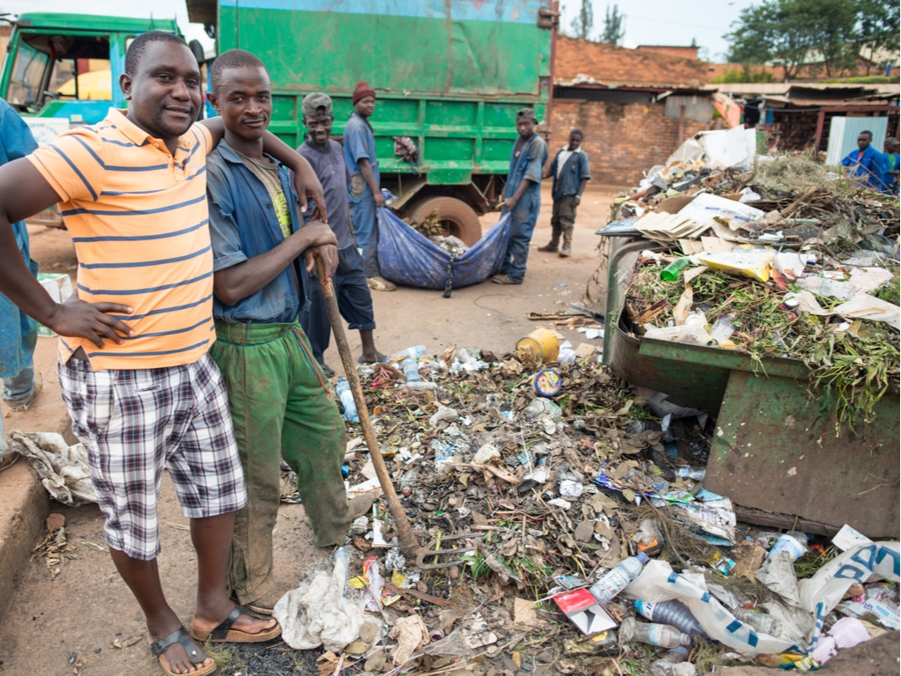
Problem Statement
In kigali city only about 24% of the solid waste generated is disposed legally [1]
Rwanda lacks proper facilities and treatment skills to deal with waste management [2]

Slide 7
Problem Statement(cont’)
Existing models rely on small, homogeneous datasets, limiting generalization
Binary classification of recyclable and non-recyclable materials
Need for comprehensive multi-class waste classification system

Slide 8

02
Overview of previous work

Slide 9
Related Works
Tran [3], focused on binary classification of organic and inorganic wastes(Binary Classification)
Altikat [4] utilized deep CNNs on TrashNet dataset for waste classification(Small dataset).
I. Mittal [5], worked on classifying garbage using Deep Learning (low accuracy).

Slide 10
Objective for this study
Employs computer vision and deep learning models for real-time waste categorization

Slide 11

03
Methodology

Slide 12
Proposed System Model
Metal
Glass
Plastic
Paper
Cardboard
Trash
Model
Classification
User Input
Processing image

Slide 13
Proposed Approach
Enhancements(Novelty):
Using customized real-time classification
Leveraging stable diffusion model (SDM) for dataset augmentation
Used CMU-Africa images and SDM for data enlargement

Slide 14

Dataset
TrashNet dataset: 2,527 categorized images of waste materials
CMU-Africa images
diffusion model images generated

Slide 15
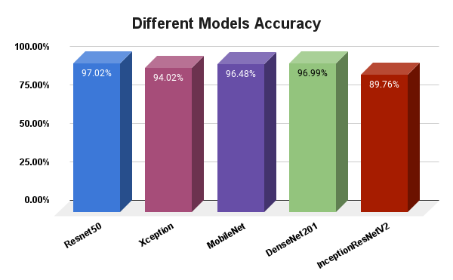
Why ResNet-50?

Slide 16
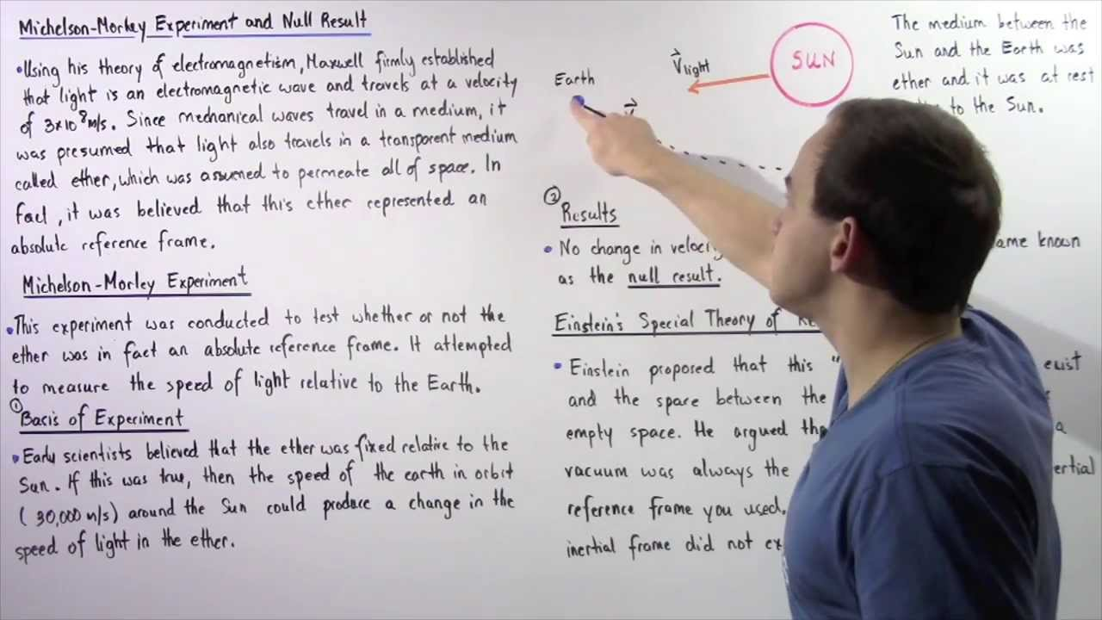
04
Results

Slide 17
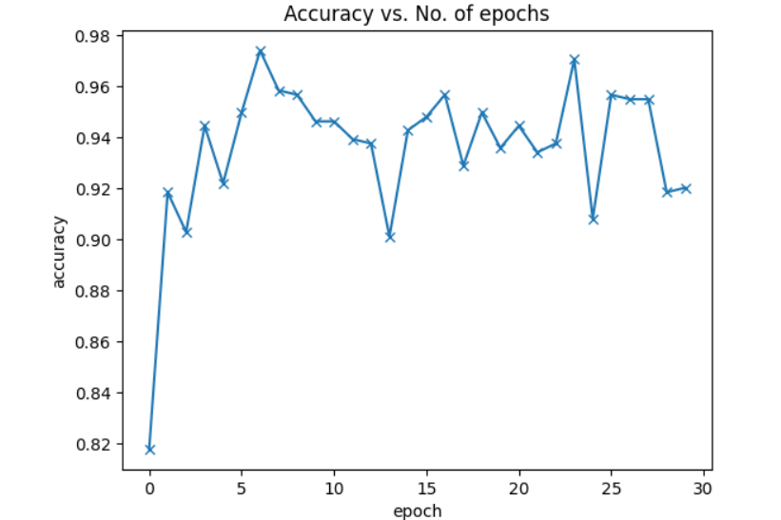
Evaluation of our model

Slide 18
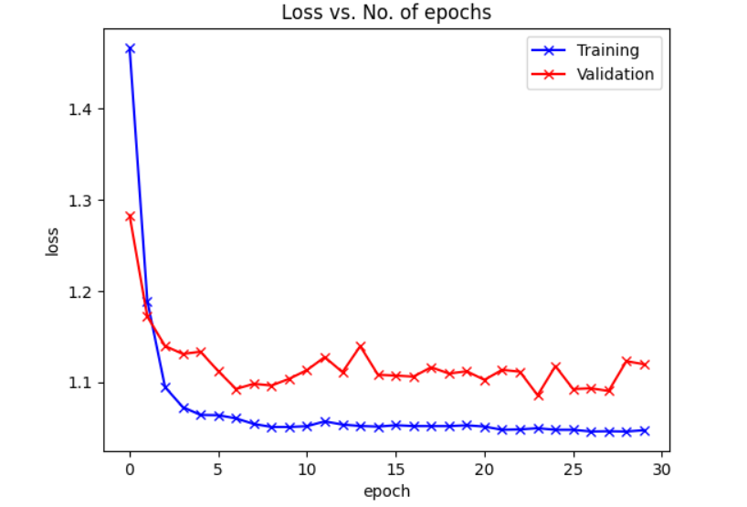
Evaluation of our model (cont..)

Slide 19
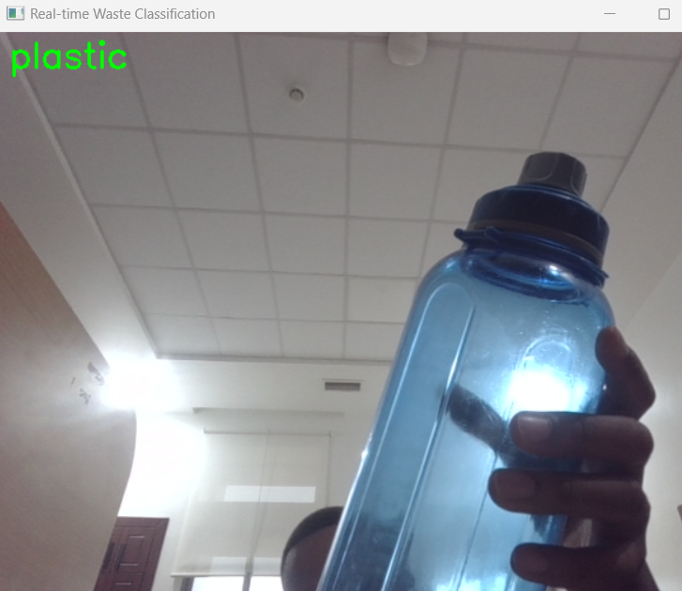
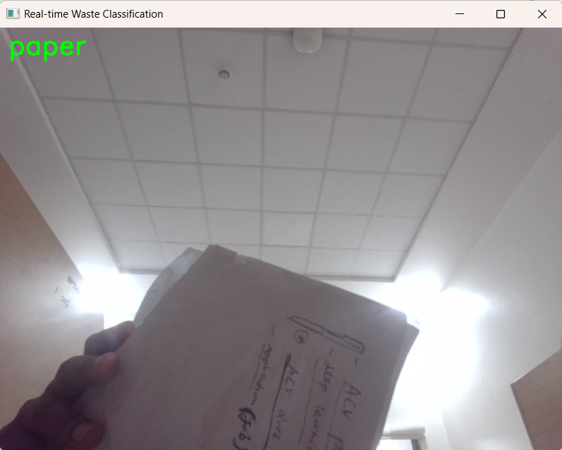
Real-time garbage classification using web camera

Slide 20

05
Future work

Slide 21
Future Work
Looking for Funding and partnership
Implementation of our project

Slide 22
References
[1] T. Tran et al., "A Deep Trash Classification Model on Raspberry Pi 4," Intelligent Automation 244 Soft Computing, vol. 35, no. 2, pp. 2479-2491, 2022.
[2]https://rema.gov.rw/fileadmin/templates/Documents/rema_doc/EIA/EIA%20Guidlines/EIA%20Guidelines%20Waste%20Management.pdf
[3] https://www.igi-global.com/chapter/solid-waste-management-in-rwanda/240081
[4] I. Mittal et al., "Trash Classification: Classifying garbage using Deep Learning," Journal of
226 engineering sciences, vol. 11, no. 7, pp. 61-68, 2020.

Slide 23

Q & A

Slide 24

Appendix: Demo

